Slide 1

Credit Card Customer Behavior
Dynamic Data Analytics
Julia Pysk, Jillian Kozlowski, Blake Murray, Isaiah Moore

Slide 2

Agenda
Background
Business Goal
Mining Goal
Data Description and Data Preparation
Exploratory Analysis
Methods and Evaluation
Recommendations and Next Steps

Slide 3

Background
Wells Fargo made over 4 billion in revenue from credit cards in 2020
84% Existing customers
16% Attrited customers
John Smith is concerned with the amount of customer churn
Background
Business Goal
Mining Goal
Data Description and Preparation
Exploratory Analysis
Methods and Evaluation
Recommendations and Next Steps

Slide 4
Business Goal
Problem
Challenges and Opportunities
John Smith is not satisfied with the number of customers leaving Wells Fargo’s credit card services
They do not know how to target their retention incentives to the correct customers, leading to inefficient use of capital
We need to create a model that can accurately predict whether a customer will leave Wells Fargo
We can compare the cost of retaining a customer with that customer’s value to decide who should be offered incentives
Background
Business Goal
Mining Goal
Data Description and Preparation
Exploratory Analysis
Methods and Evaluation
Recommendations and Next Steps

Slide 5
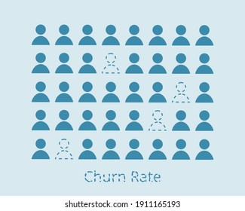




Data Mining Goal
Goal:
Predict which customers are likely to churn
Target Variable:
Attrition_Flag
Classification Problem
Background
Business Goal
Mining Goal
Data Description and Preparation
Exploratory Analysis
Methods and Evaluation
Recommendations and Next Steps
Success:
Customers most likely to churn are offered incentives and will ultimately stay with Wells Fargo
Supervised Learning
Notes:
Goal
Target variable is attrition_flag, representing whether a customer will stay at wells fargo or will close their account
Classification problem since a customer is either existing or leaving
Models we created was used with supervised learning, however we did initial exploration using an unsupervised model
Our success will be identifying which customers are going to leave & offering these leaving customers incentives to stay

Slide 6



Data Description
Data Source: Kaggle
10,127 Instances
21 Features
6 Categoric Variables
14 Numeric Variables
https://www.kaggle.com/sakshigoyal7/credit-card-customers
Background
Business Goal
Mining Goal
Data Description and Preparation
Exploratory Analysis
Methods and Evaluation
Recommendations and Next Steps

Slide 7
Data Preparation
All features were used
No issues with data leakage
No missing values
Rescale numeric features 0-1
Recode categorical features as indicator variables
Partition: 70/15/15
Background
Business Goal
Mining Goal
Data Description and Preparation
Exploratory Analysis
Methods and Evaluation
Recommendations and Next Steps
Notes:
Our dataset was mostly prepped & ready for analysis
We checked that features were relevant to our data mining goal &
We rescaled features to make sure that one variable didn’t have a larger impact on results than others

Slide 8


Exploratory Analysis
Clustering
Logistic Regression Importance
Positive | Negative
Transaction Count Q1 – Q4 Change Total Revolving Balance Relationship Length | Transaction Amounts Months Inactive Contacts to Bank Lower Education
Segment 1
Attrited Customers
Low Revolving
Balance
Low Utilization Ratio
Segment 2
Existing Customers
Segment 3
Existing Customers
8% and 7%
Attrited
Higher Total # of
Transactions
Retention
Attrition
Background
Business Goal
Mining Goal
Data Description and Preparation
Exploratory Analysis
Methods and Evaluation
Recommendations and Next Steps
Notes:
Graphs with descriptions
Provide initial understanding of the problem and the dataset
Identify important features
Good predictors of churn
3 clsuters – elbow method
2 & 3 had similar rates o attrited customers 1 = 34%. 2 = 8%. 3 = 7%
1 had a low reovling balance the money carried is low, utilization ratio low - people left
2 & 3 similar, alternate categories, age of relationship was not an indicator - existing customer
Importance = total number of transactions, quartley change , months inactive is negative coefficeints, contacts to bank is negative

Slide 9




Methods
Classification Models
Tuned Hyper-Parameters
Test Data
Best AUC Performance
Models | Cross Validation – Test Set AUC
Random Forest | 0.9890
Decision Tree | 0.9455
ANN | 0.9666
SVM Radial | 0.9576
SVM Polynomial | 0.9295
Logistic Regression | 0.9362
Ada Boost | 0.9897
Background
Business Goal
Mining Goal
Data Description and Preparation
Exploratory Analysis
Methods and Evaluation
Recommendations and Next Steps

Slide 10
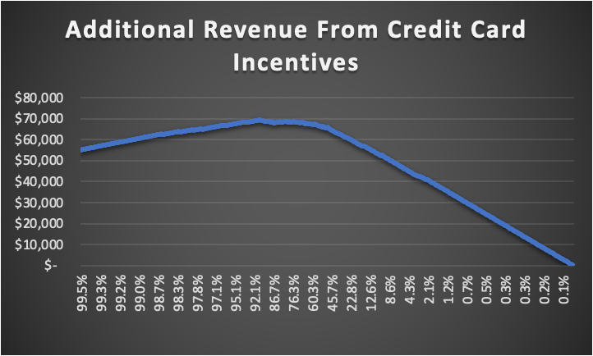
Cost Matrix
True Positive
False Negative
False Positive
True Negative
0
-100
Background
Business Goal
Mining Goal
Data Description and Preparation
Exploratory Analysis
Methods and Evaluation
Recommendations and Next Steps
0
300
Likelihood a Customer Stays Without Incentive

Slide 11





Conclusion and Recommendations
A few features have a large impact on the chance a customer will leave:
Revolving Balance
Utilization Ratio
Volume
The Adaboost model was able to best predict classification
Incorporating the cost of incentives and the value of customers allows for better decision making
Revenue is maximized by offering incentives to any customer with a greater than 9% chance of leaving
By increasing revenues by 10%, our model can create an additional $450 million in yearly revenue if applied to all Wells Fargo credit card customers
Background
Business Goal
Mining Goal
Data Description and Preparation
Exploratory Analysis
Methods and Evaluation
Recommendations and Next Steps

Slide 12

Next Steps
Improvements
Using the Model
Collect and update data quarterly
Collect more instances and features relating to leaving customers
Optimize cost curve based on actual data for incentive costs and revenues
Enter new data in the model, if a customer’s chance of leaving is 9% or higher, offer them incentives
Background
Business Goal
Mining Goal
Data Description and Preparation
Exploratory Analysis
Methods and Evaluation
Recommendations and Next Steps
Notes:
1. In case big changes happen, make sure data is relevant
2. Add more instances, since majority of current data (84%) is on existing customers
2. We can add more features that would give insight to characteristics of leaving customers
3. Since we didn’t have information on Well’s Fargo’s incentive costs, we had to estimate it using their past financial data
3. Wells Fargo might also have data on the true cost of a lost customer or how large the incentive needs to be in order to get the customer to stay
3. If we were to add these to our model, the model will be more tuned to Wells Fargo’s specific business model

Slide 13
Questions?

